Slide 1

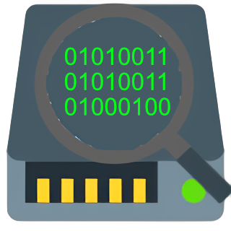
Using Model-Simulation to Drive Generative Validation
SSDynamics - Team 4
Charles, Chas, Connor, Carter
Mentor: Savannah Chappus
(Brian Donnelly)
Notes:
Charles - Introduction (<30 seconds)
Hi everyone, we are SSDynamics. Our project is Using Model Simulation to Drive Generative Testing Validation. Our mentor is Savannah and Brian.

Slide 2

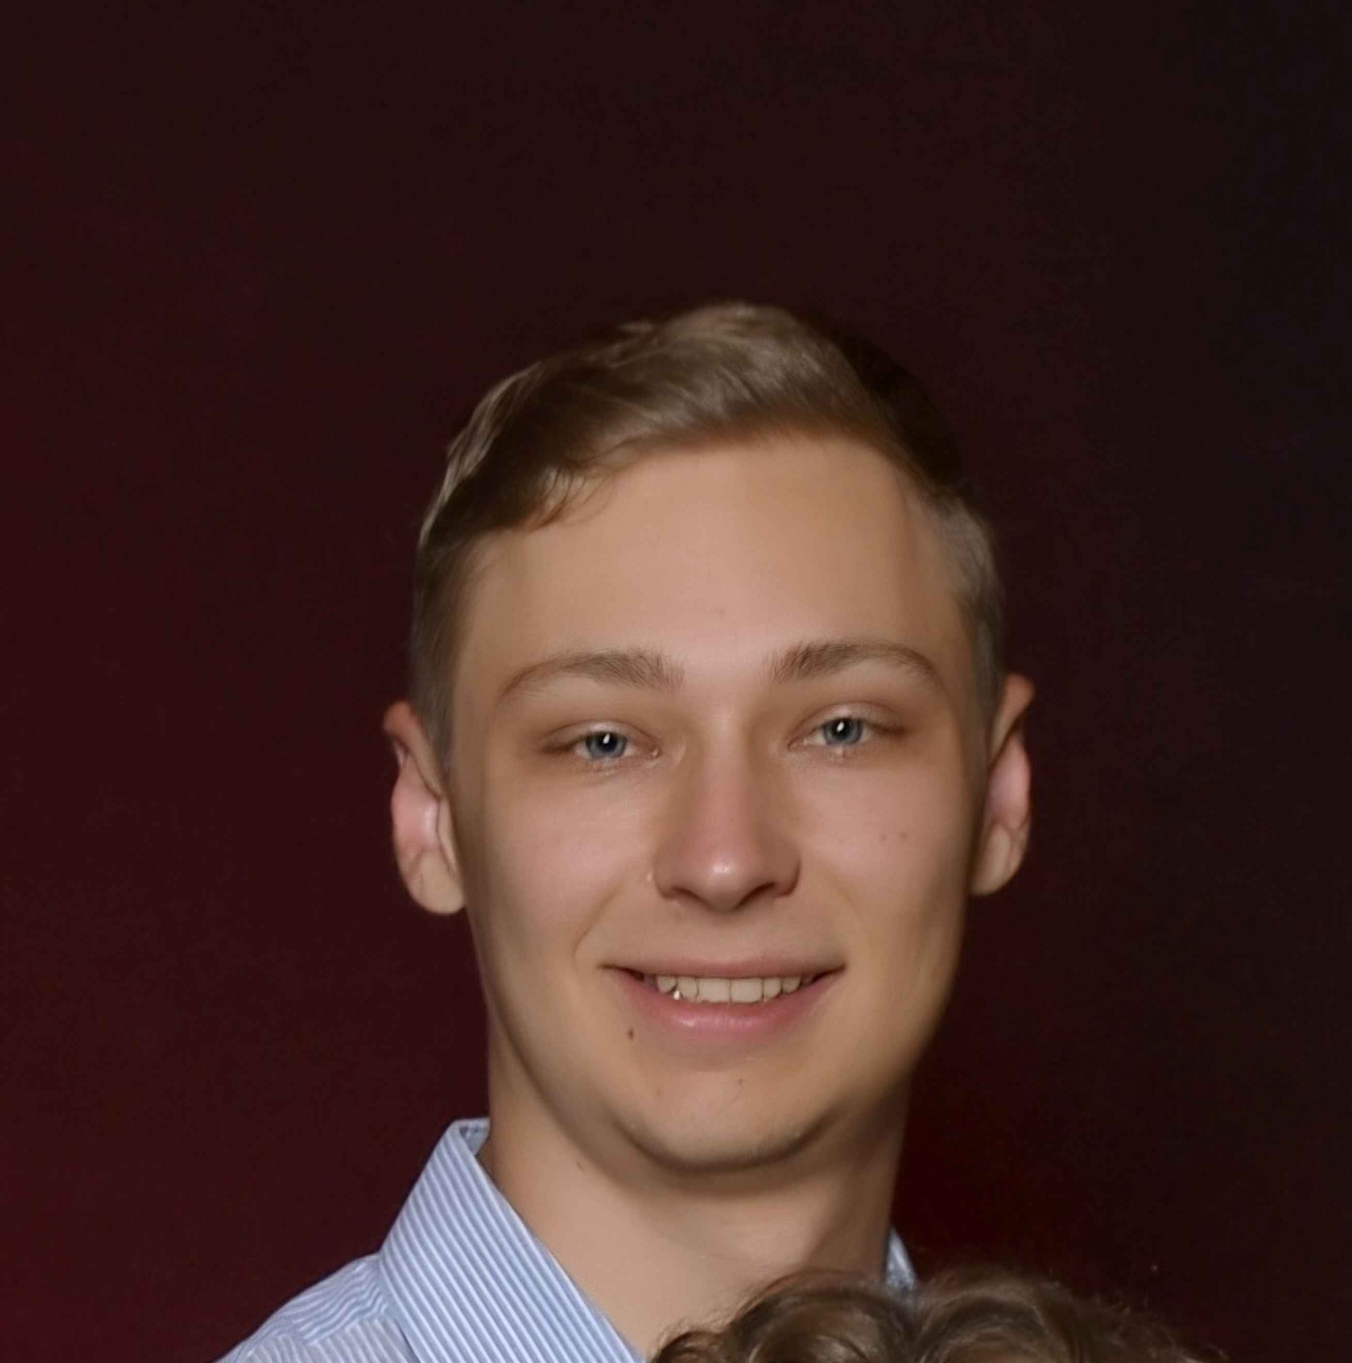
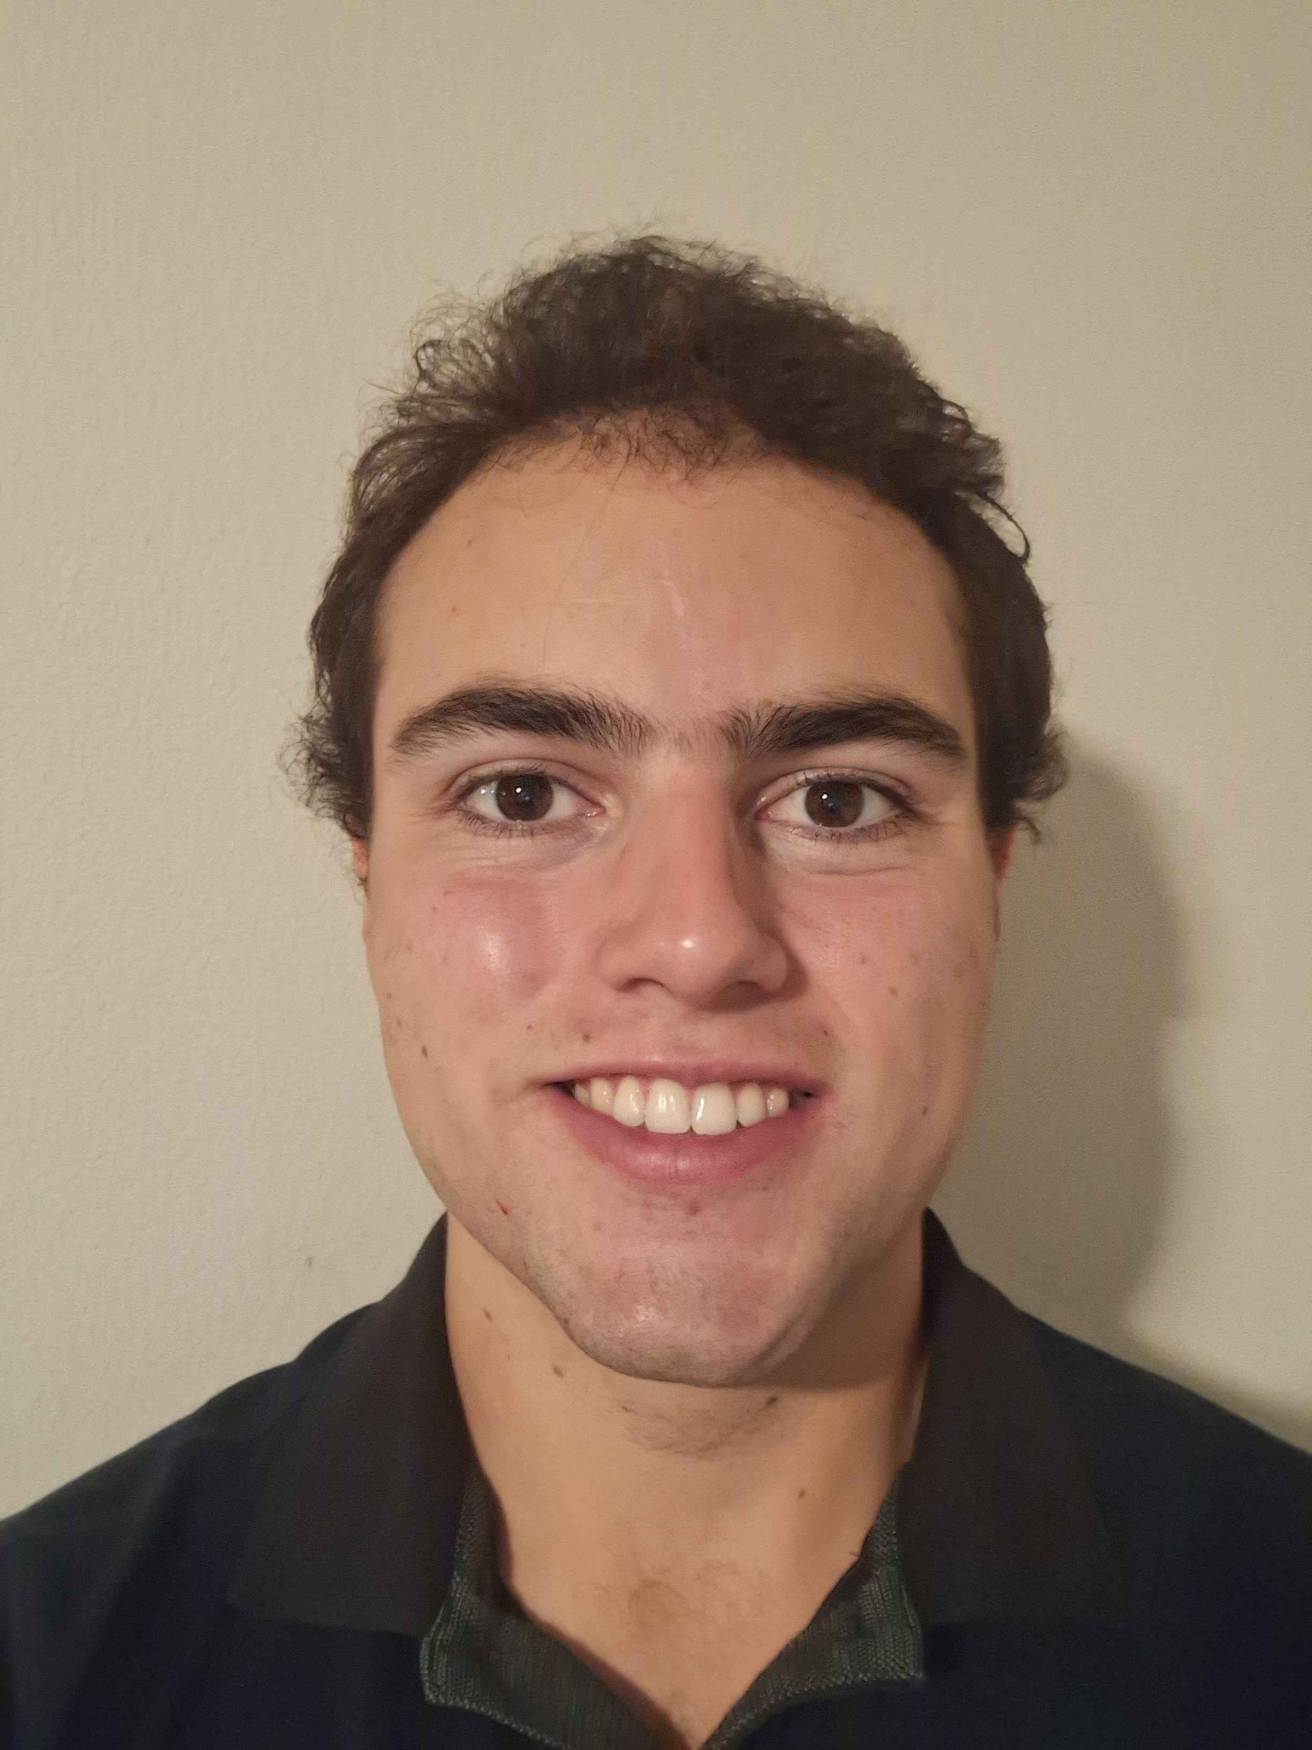
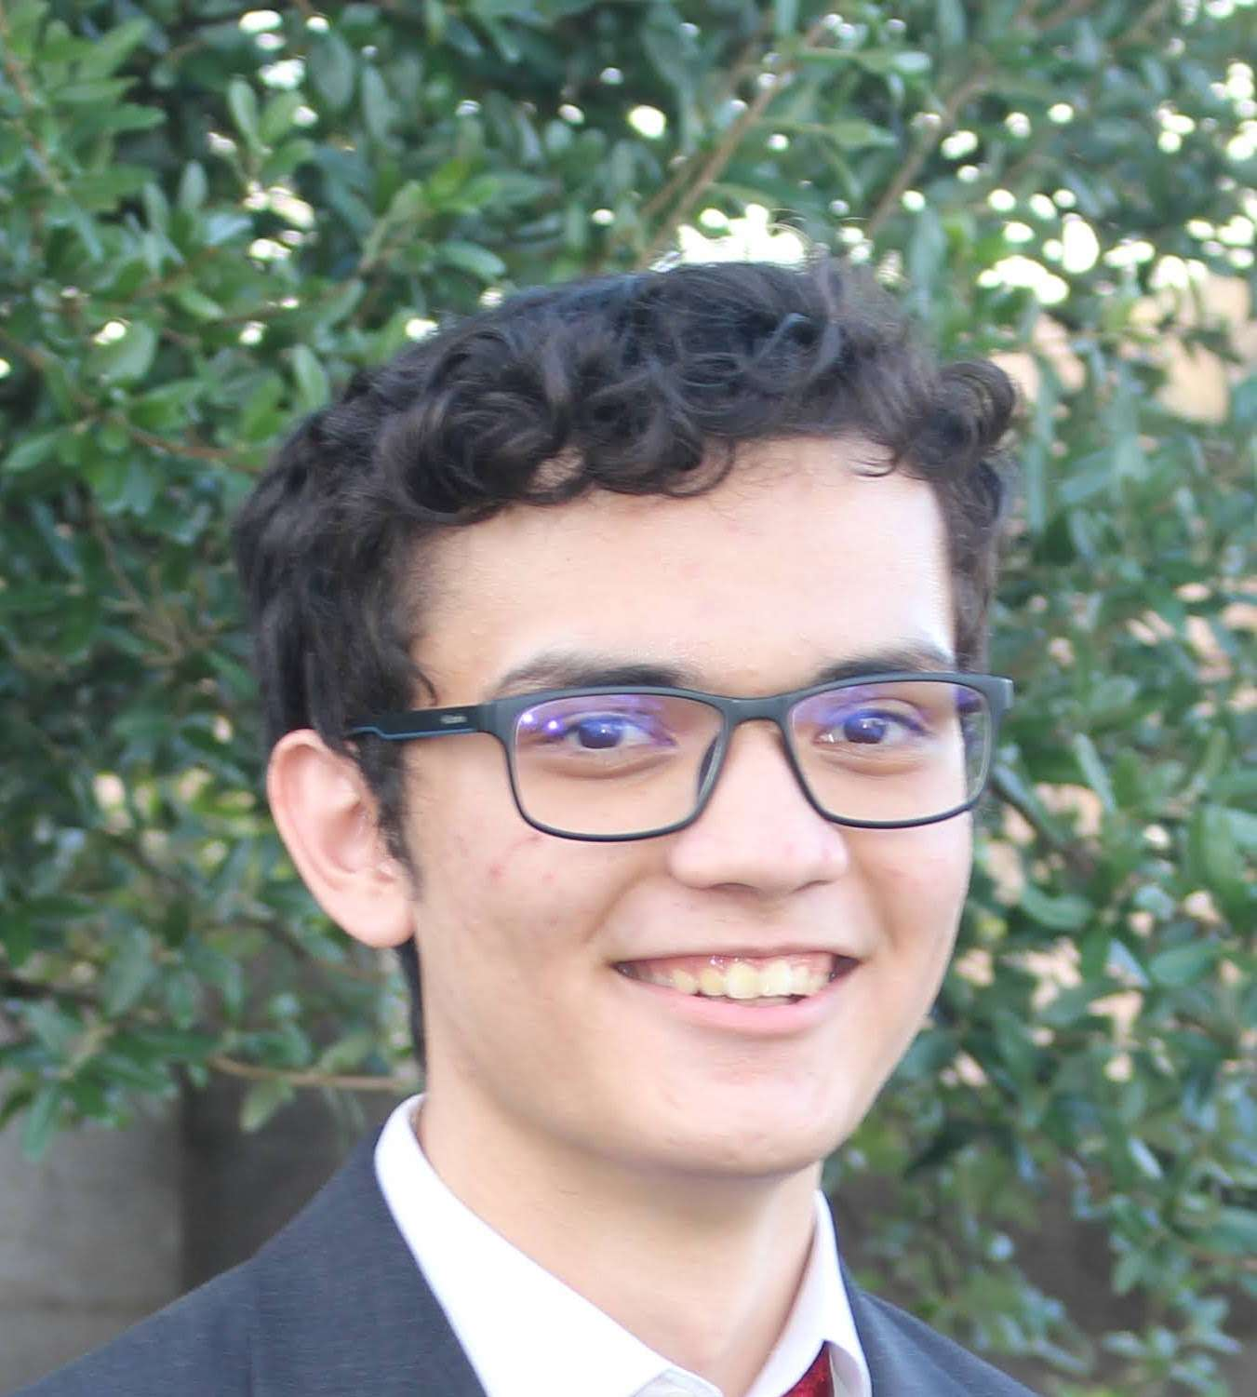
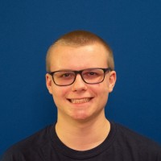
More About The Team
Charles (Chas) Diaz
Carter Kaess
Connor Aiton
Charles Descamps
Recorder &
TLA+ model maker
Logging Specialist & TLA+ model maker
Architect &
Release Manager
Team Lead &
Testing Designer
Notes:
Chas - Client - add logo

Slide 3


Client
Western Digital/Sandisk
Global storage company
12.13 billion market cap
Notes:
Chas - Client, more information

Slide 4
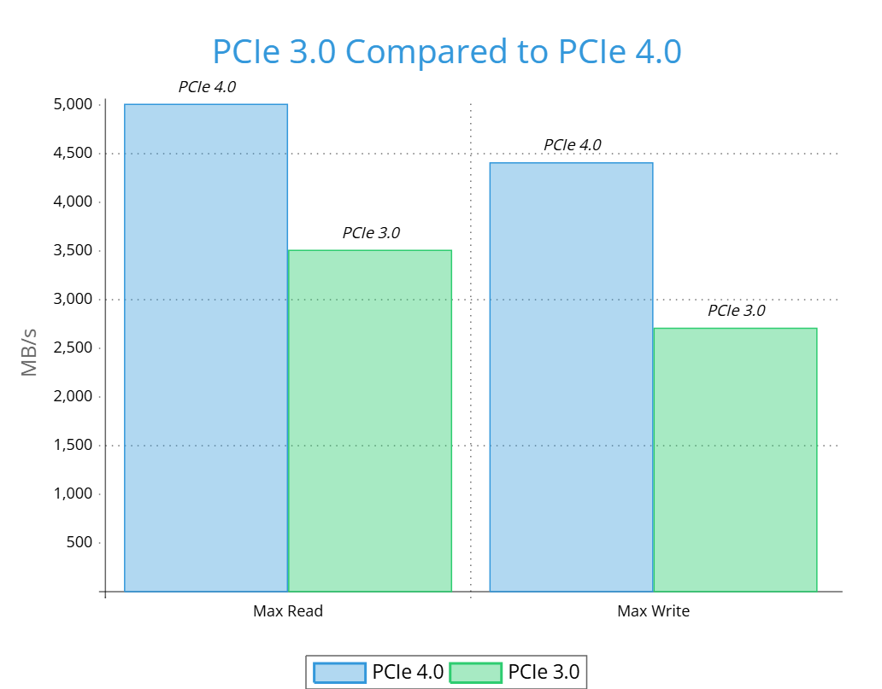
The Problem
3.0 PCIe -> 4.0PCIe
Boot Times affected
Faster load times for programs
Current Testing
SSDs are getting faster with each new generation.
Can lead to less stability.
Creates a need for better and thorough testing.
Notes:
Explain how the business works and how it would go about testing/validating nvme ssds
Chas - Problem Statement (2-3 minutes)
SSD PCIe speeds has been rapidly growing, between the last two generations the speed have almost doubled.
This is a great thing for everyone. It means faster boot times for a computer and faster times program load times.
However, with each new generation there comes the challenges of developing new products.
There is a lot of development that is needed for each new SSD and along with that comes a lot of testing to make sure that the ssds are actually working properly.
Explain what is deficient about current testing/validation process
Talk about file management being faster.
This leads to faster file loading and saving.
Since SSDs are getting faster, this leads to less stability.
With this, there is a need for better and thorough testing.
Explain PCIe

Slide 5
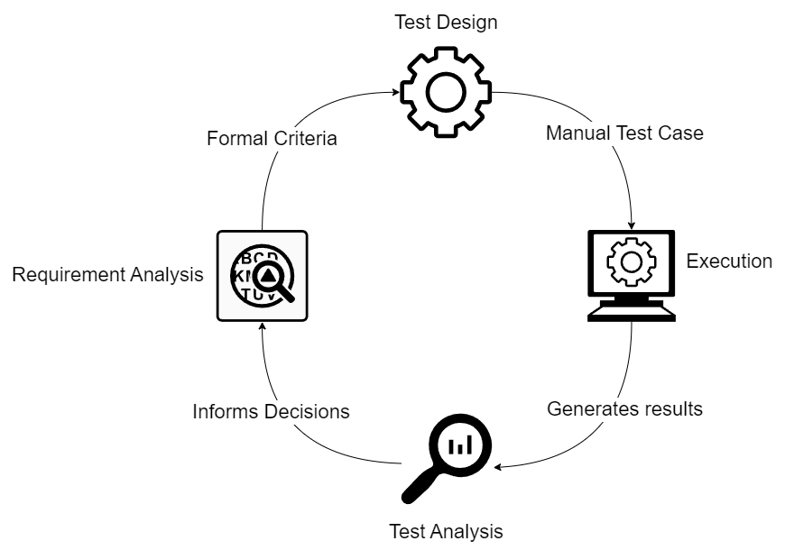
Current Testing Workflow
Notes:
This is the current testing workflow
individual testers use a test design, which includes the individual test cases and the expected output after the command is run.
each test design is focused on testing one specific NVMe command. This ensures the device complies with the NVMe specification, one command at a time.
After the command is run on the NVMe CLI the output is analized by the tester and compared to the expected output.
If errors occur the tester needs to review the lengthy CLI output to find the root of the flaw.
this and other information is used to update the device if errors are found.
The tester then goes through the same process with another test design

Slide 6
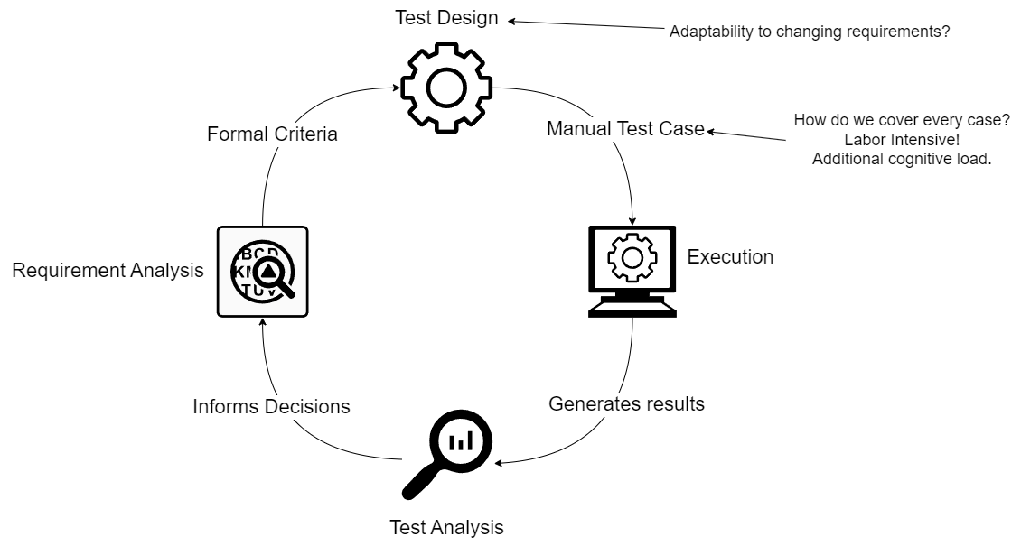
Current Problems
Notes:
problems with this method
test design is fixed during any given cycle, this prevents adaptability in one testing iteration,
as each test design only focuses on one command
tests are created manually and run individually. This is time consuming and edge cases are often missed
Testers must go through the new and updated NVMe specification every time a new version is released and update old commands, find new commands, and new functionality and only then implement a new test design that ensures the new features are implemented and work as expected

Slide 7
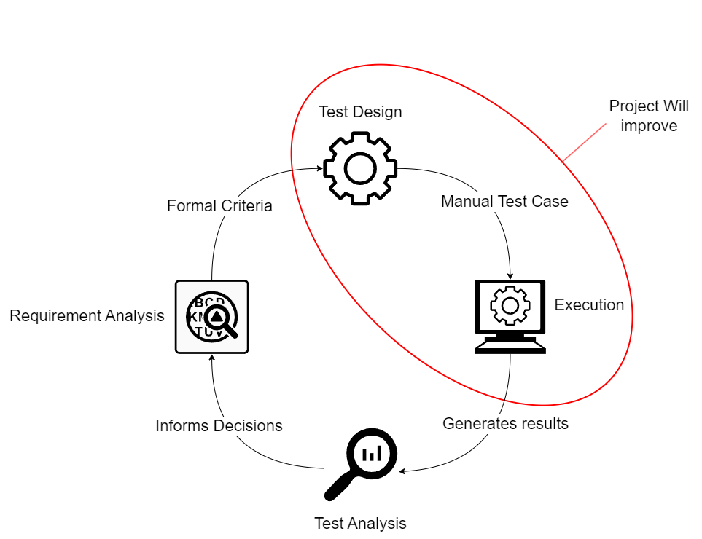
Our Solution
Notes:
our project will improve the test design, and execution phases of this testing cycle.

Slide 8
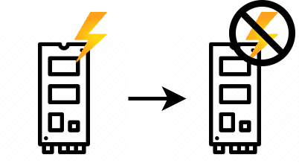
NVMe Validation
Scenario
Power State | Description
PS0 | Full power, high consumption
PS1 | 20% Reduced power
PS2 | 40% Reduced power
PS3 | Very low power
PS4 | Non operational
You are a test engineer
NVMe drives have different power states
You are given the task to validate the ability to transition between the power states 10 times
Improper power state transition causes NVMe drive to break and become inoperable
Ex.
PS1
PS4
Notes:
Connor

Slide 9
Normal Validation Process
Normal Validation
In order to test every single sequence:
You would have to think of different test sequences to cover edge cases
In complex problems, cannot validate every outcome
Prioritize the test cases that cover large grounds and likely to happen
This problem can be represented as a combinatorics problem:
S = s × (s - 1)^{n}
5 states × (4 choices)^{10 transitions} = 5,242,880 sequences
If we added just 1 more transition to the problem…
5 states × (4 choices)^{11 transitions} = 20,971,520 sequences
Testing every case becomes highly impractical as complexity becomes highly exponential!
Notes:
Connor

Slide 10
Solution Overview
Solution: We built a model simulator driven testing tool that utilizes random seeded exploration to generate unexplored test sequences.
Before | After
Human created test cases | Computer generated test sequences
Only explores cases humans explicitly come up with | Random exploration
Time consuming and tedious creation of testing sequences | Reduces time spent create testing sequences
Machine stops after running all human defined tests | Machine continues to find new sequences off of a new random seed
Notes:
Connor

Slide 11
How it Works - TLA+
TLA+ Simulator:
Ex. Conceptual Graph: Valid Words
Sees the world as a state space, represented as a directed graph
Each node in a graph represents a state
Each node transitions to another node, represented by an arrow, which is like the “action” to get to another state
Explores deep and depth first
Random exploration sequence
INIT: Start with the letter C
INVARIANT: Every next letter must align with a valid word
?
1: C
C
CAT
C
2: O
CA
2: A
3: T
CO
?
?
CA
3: O
3: R
CAR
?
4: L
COO
COOL
Notes:
Connor

Slide 12
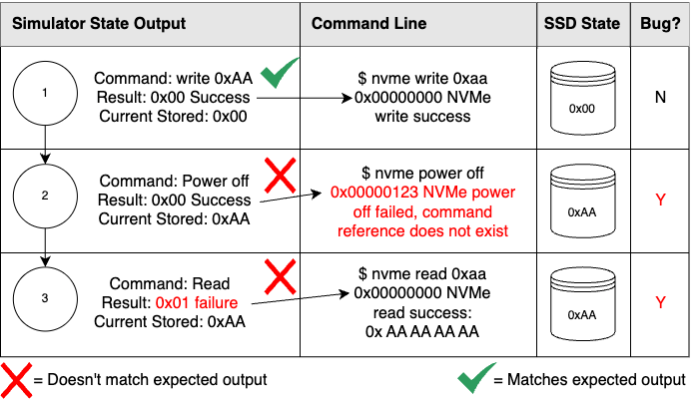
TLA+ Application
Ex. Conceptual Graph: Test Sequence
To Make the Simulator Useful
INIT: Starting command
INVARIANT: Command has valid setup and inputs
Treat each state as a step in a testing sequence
Format TLA+ output into a runnable command
Output simulated result, which should match real world result
Report any unexpected behavior to analyze
* Test process simplified for clarity
Notes:
Connor

Slide 13
How it Applies
How it Improves Validation
Uses computational brute force to generate test sequences
Does not guarantee full exploration of complex validation within a realistic time
Increases chances of finding bugs
Allows for better usage of idle resources
Validate with logical language rather than directly instructing what to do
Notes:
Connor

Slide 14
Functional Requirements
Key Features
Must be able to call NVMe CLI commands through Python
Must be able to parse through TLA+ files in Python
Must be able to get logging information from NVMe-CLI commands
Randomise test keys for each command call
Implementation
TLA+ File
parser.py
nvme.py
logging.py
Notes:
Chas
Change this to focus on requirements, like we must include tla+ file that can be parsed by python

Slide 15
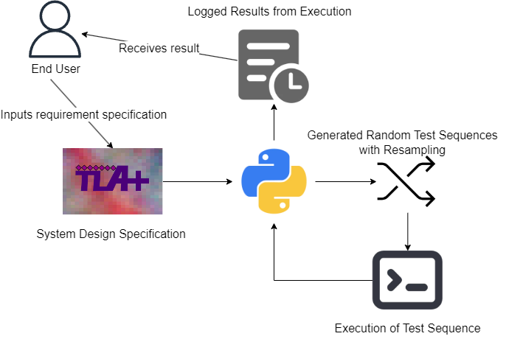
Architecture Overview
Notes:
Carter
As shown in this diagram, our program starts with a TLA+ file, which is written by the tester. This file defines how the NVMe device is expected to behave—essentially, it models correct behavior.
Next, we use Python to parse the TLA+ specification. This lets us generate a series of NVMe commands based on the model.
We then use the NVMe CLI to actually send those commands to a real NVMe device such as a Solid State storage device. These commands are run in a specific sequence, similar to how the device might be used in a real-world situation.
That sequence is determined by a random testing seed, which gives us a reproducible but randomized order of operations.
Finally, another Python file reads the output from the CLI—including any errors—and saves it to a rolling log file, so the tester can review exactly what happened during the test run.

Slide 16
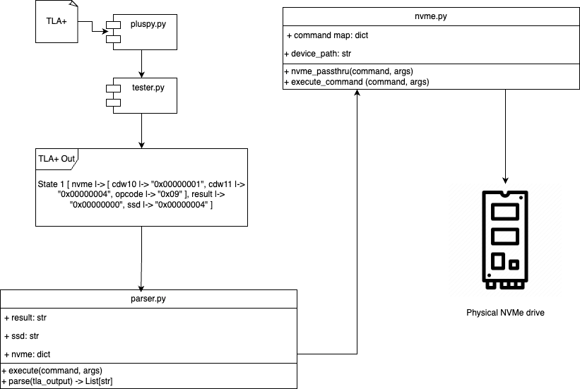
Implementation Details
TLA+ Parsing
Takes TLA+ output, deconstructs it into python variables and arguments
Notes special variables like result, nvme and ssd which changes how the simulator will submit commands
Sends final command to nvme.py
NVMe-CLI command calls
Based on input command, decides whether to submit an admin or IO command
Uses system libraries to submit CLI commands
Notes:
Carter
Let me walk you through a bit more detail about how our system works behind the scenes.
We start with a Python script that parses a TLA+ specification file. As explained by Connor, TLA+ is a formal modeling language used to describe how systems behave—specifically, it defines valid states and the transitions between them. We use a library called Pluspy, along with Our parser to read the spec and extract the NVMe operations that need to be tested, along with the rules that define how they can be ordered. This gives us the structure for generating valid test cases.
Next, we move into test scenario generation. By default we use a random number generator that's seeded at the start of each test run. Otherwise the tester will provide their own testing seed. This seed controls the specific sequence of NVMe commands we generate—commands like read, write, or flush—which are arranged to simulate real-world usage patterns,
Our program is also able to determine what kind of command to call, either admin or IO based on the TLA+ file. This is necessary to form a proper NVMe cli command.
If an error occurs during testing, the system will automatically resample using a new seed. This helps isolate which specific command sequence triggered the error. Both the error and the new seed are saved to the log, which makes it much easier to reproduce and debug rare or intermittent issues.
Once the test sequence is built, we use Python to send those commands directly to the SSD via the NVMe command-line interface. Commands like read, write, or identify are executed in order, and we capture the output and any errors that are returned.
Finally, all of that output is handled by our logging system. Results are written to a rolling log file that includes a timestamp for every entry. The log is automatically trimmed when it reaches a certain size, keeping storage use under control. the log includes the full command sequence, the test seed, and any unexpected behavior or errors encountered. At the end of the file, a summary lists critical errors, making it quick and easy to identify what went wrong and where.
This makes the entire testing process reproducible, traceable, and very tester-friendly.
Chas will now walk though our demo

Slide 17
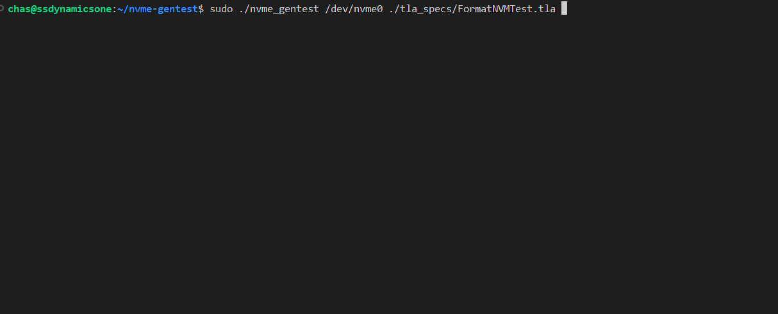
Default Command Call
*Live demo
Notes:
Chas
our command, device path, tla+ file
-typical user case

Slide 18
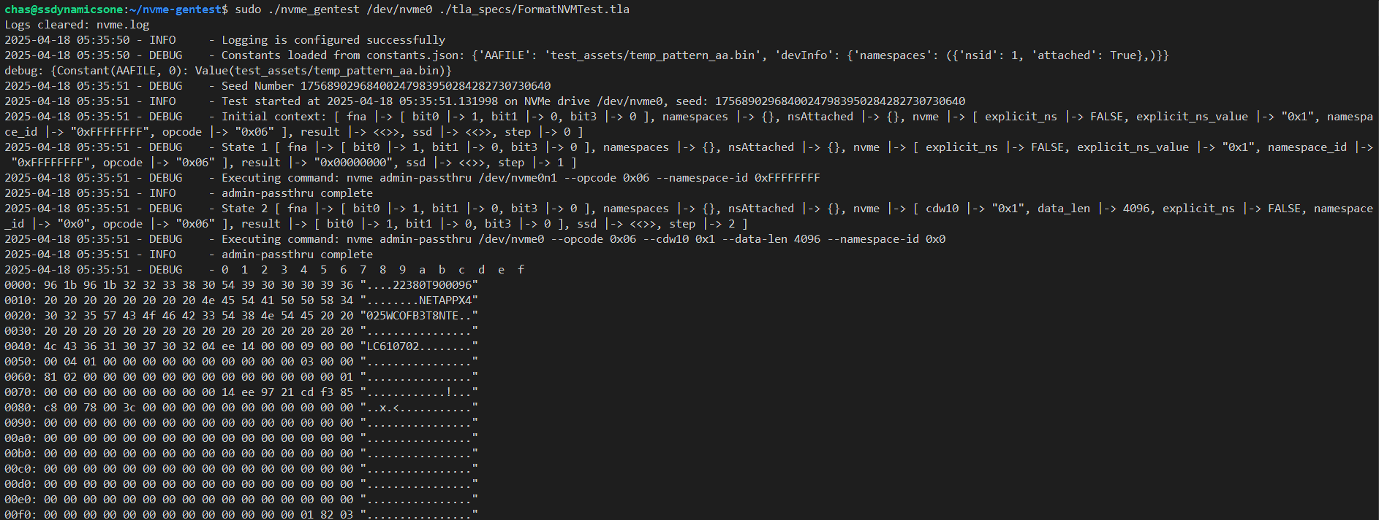
Command Execution
*Live demo
Notes:
Chas

Slide 19
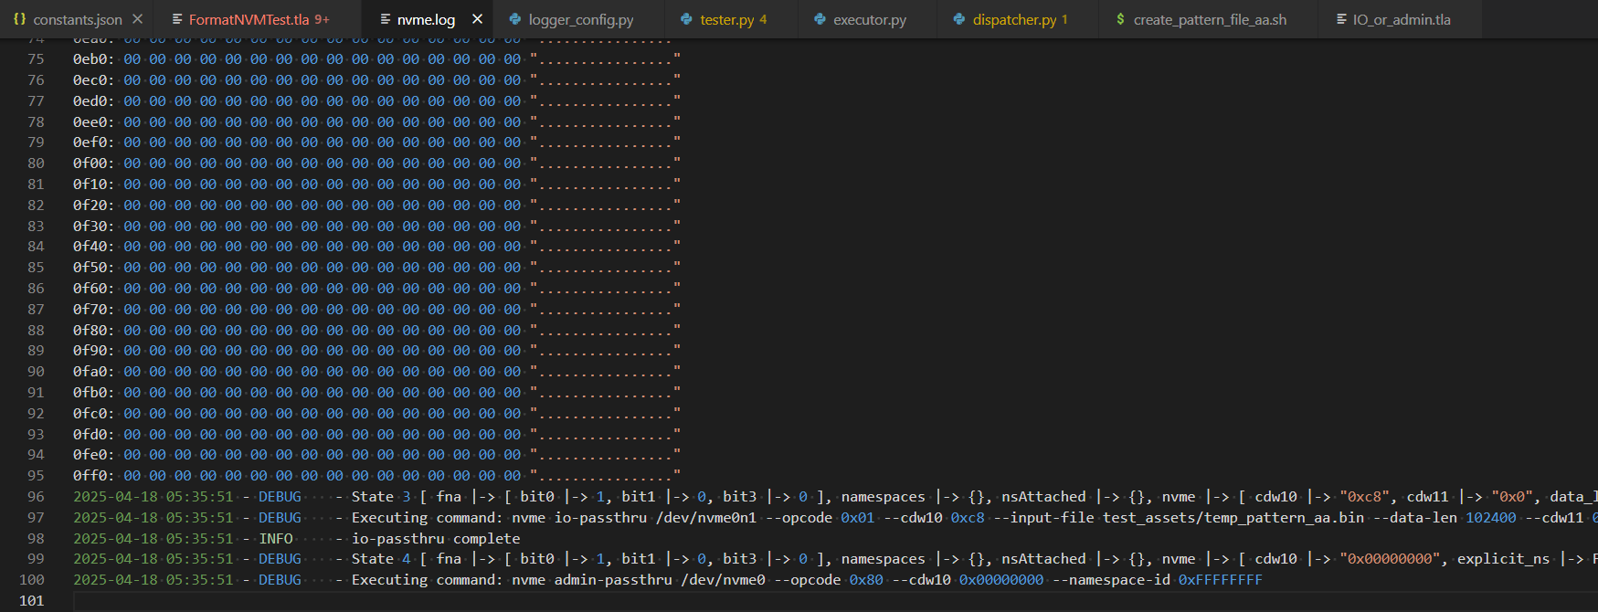
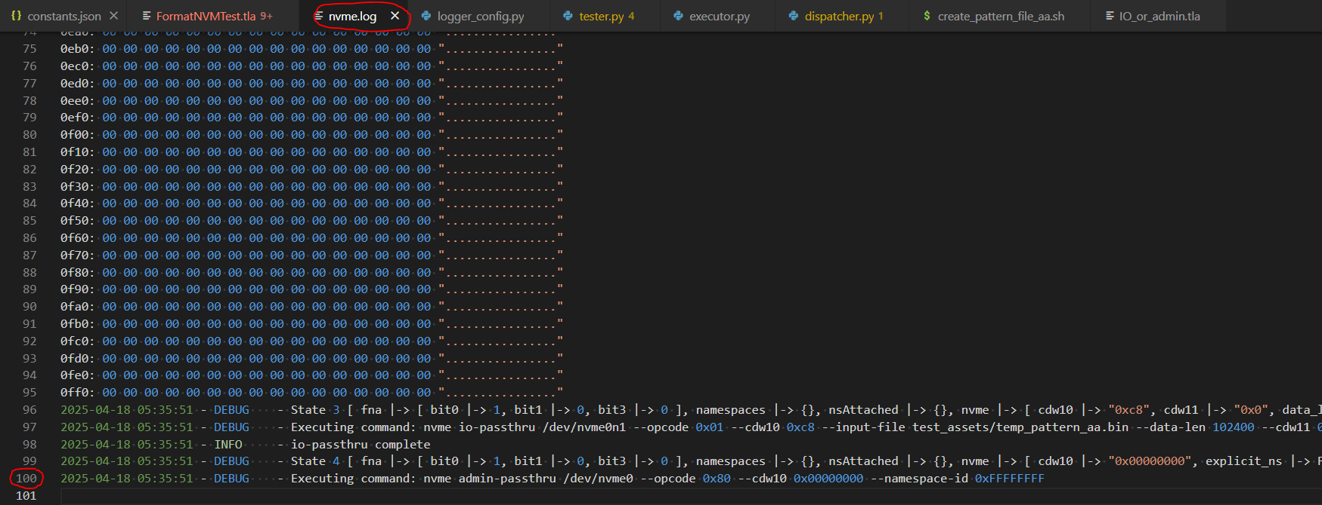
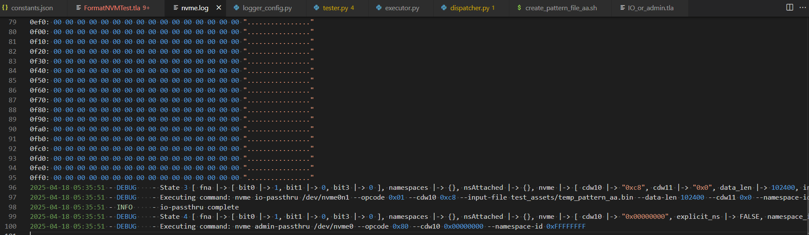
Default Line Length
*Live demo
Notes:
Chas

Slide 20
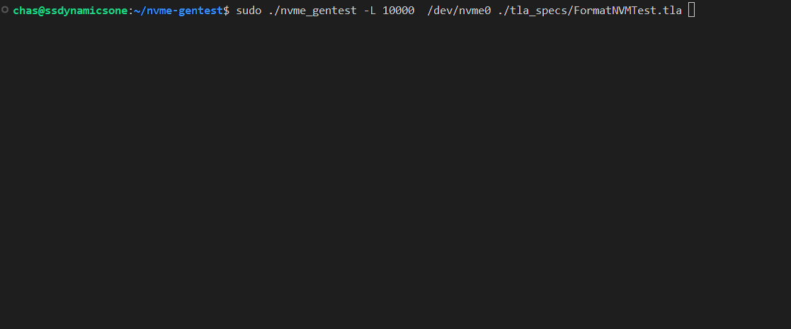
Change The Line Length Command
*Live demo
Notes:
Chas

Slide 21
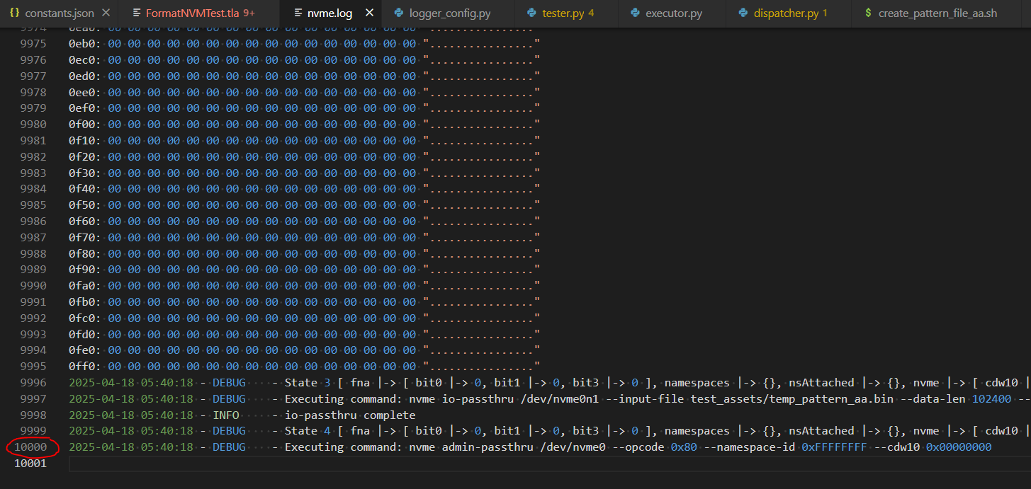
Adjusted Line Length
*Live demo
Notes:
Chas

Slide 22
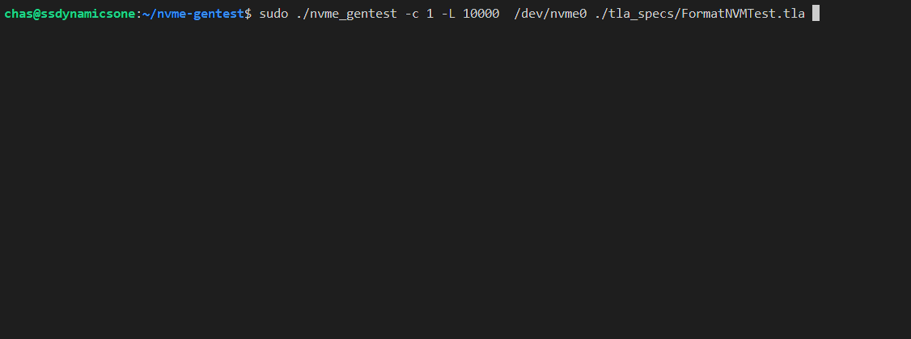
Execution Count Command Example 1
*Live demo
Notes:
Chas

Slide 23
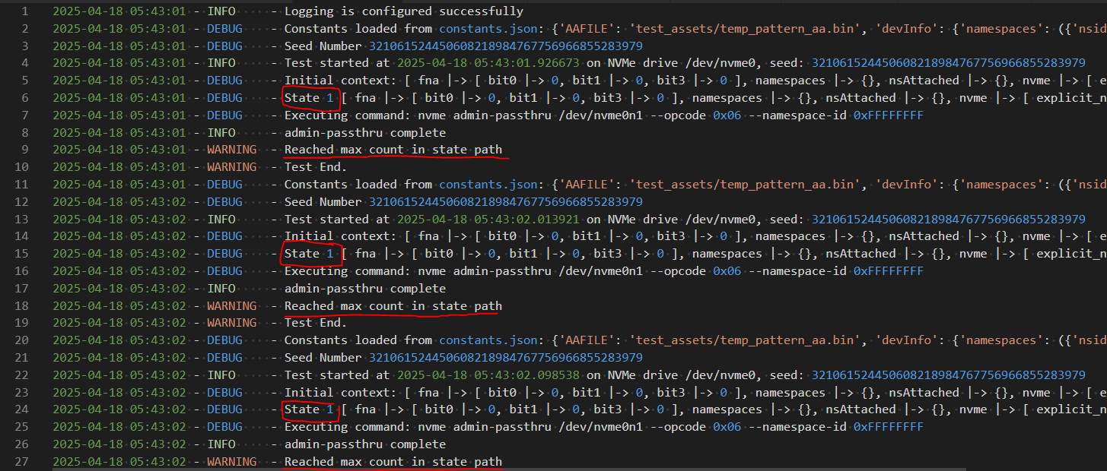
Execution Count Command Example 1
*Live demo
Notes:
Chas

Slide 24

Execution Count Command Example 2
*Live demo
Notes:
Chas

Slide 25
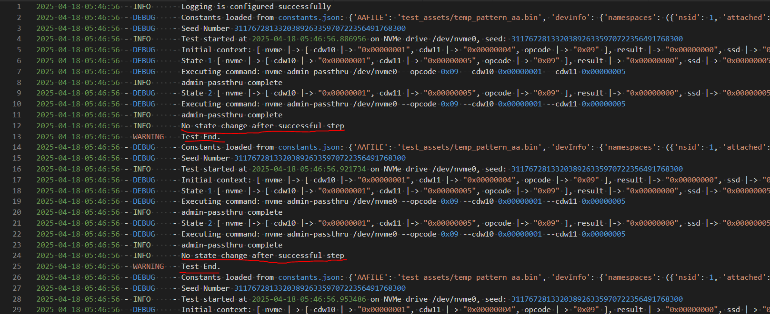
Execution Count Command Example 2
*Live demo
Notes:
Chas

Slide 26

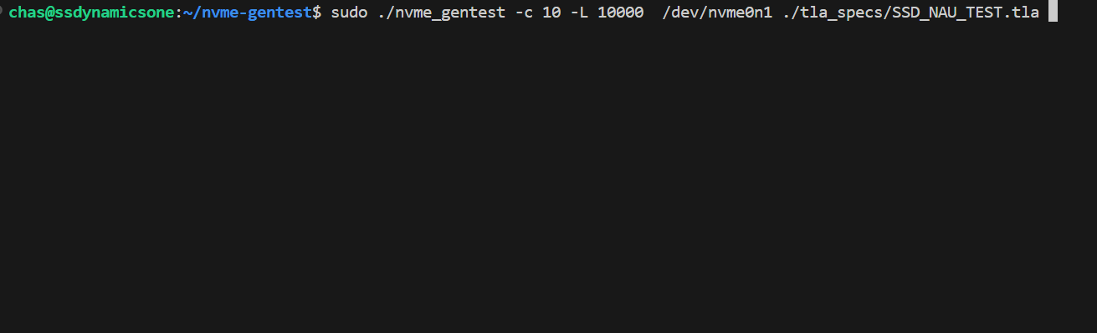
Incorrect Command Call
*Live demo
Notes:
Chas

Slide 27
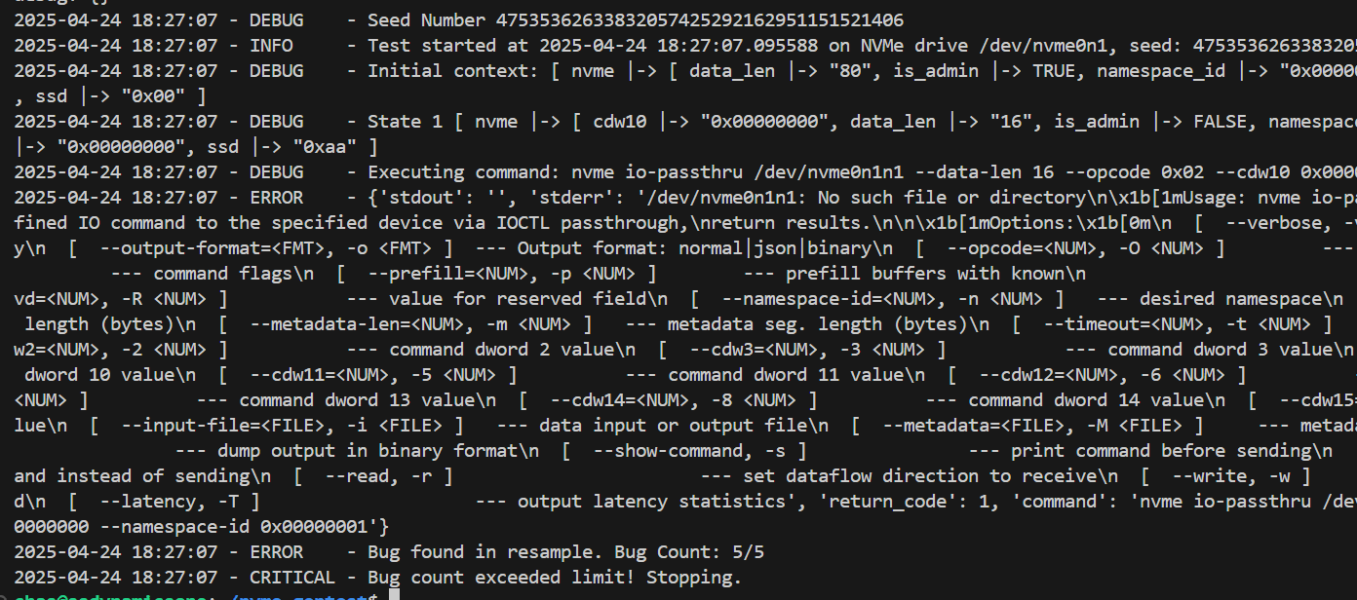
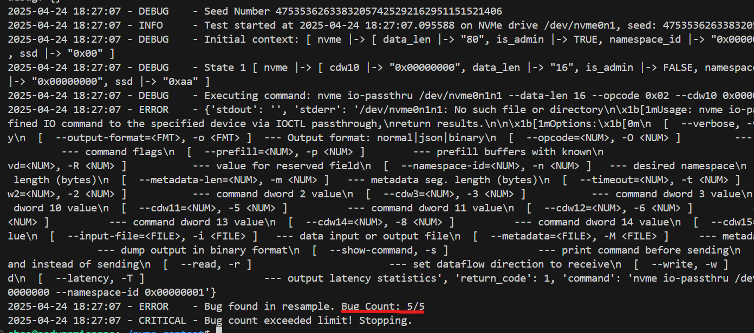
Incorrect Command Call
*Live demo
Notes:
Chas

Slide 28

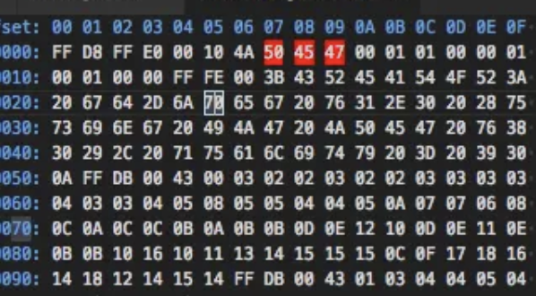
Challenges & Resolutions
Code
---------------------- MODULE TLA+ ----------------------
INIT == ^Mathematical In Nature
^Need complete understanding of the specific command being modeled
^Time and patience to understand and build specifications
How do we compare I/O hex dumps for patterns?
“Special” variables
Way of passing external factors
Must be extendable/modular
Notes:
Connor + Carter
In development we have had a few issues The main difficulty with TLA+ is its mathematical nature.
This leads to a very different way of thinking from how one would think when programming.
instead of following a singular flow, TLA+ creates a state graph that will be exhaustively searched, meaning all possible states in all possible orders will be explored.
Another challenge is that we need a complete understanding of the command being modeled, including the possible states.
this ensures that the entire command is modeled and all states are present so that the test is accurate to the real world.
the last challenge is that NVMe requires a lot of time and patience to understand and build the TLA+ specification.
The NVMe specification spreads several documents and combined are over 900 pages of densely worded technical information.
Taking the time to thoroughly understand the specification of the commands we are implementing is required to re-create the commands in TLA+. This ensures they accurately represent the real world command

Slide 29
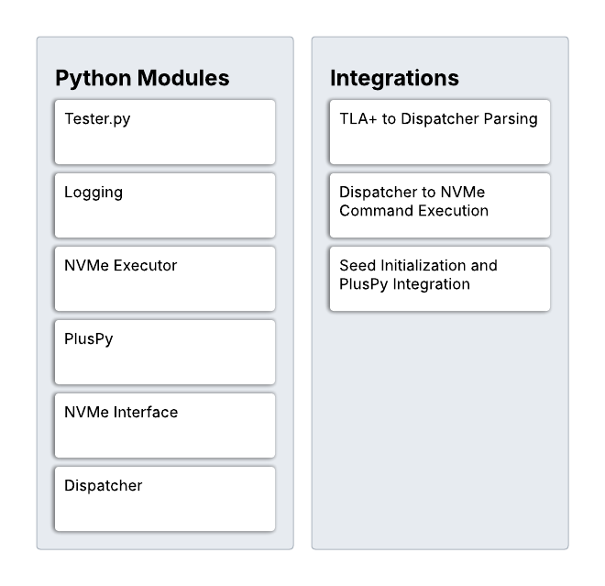
Testing Plan
Unit Testing
Test each module
Including our modified library
Integration Testing
Test the module interactions
Make sure they work as intended
Usability Testing
Hand off the platform to the engineers to try out
Get feedback from the engineer
Notes:
Charles

Slide 30
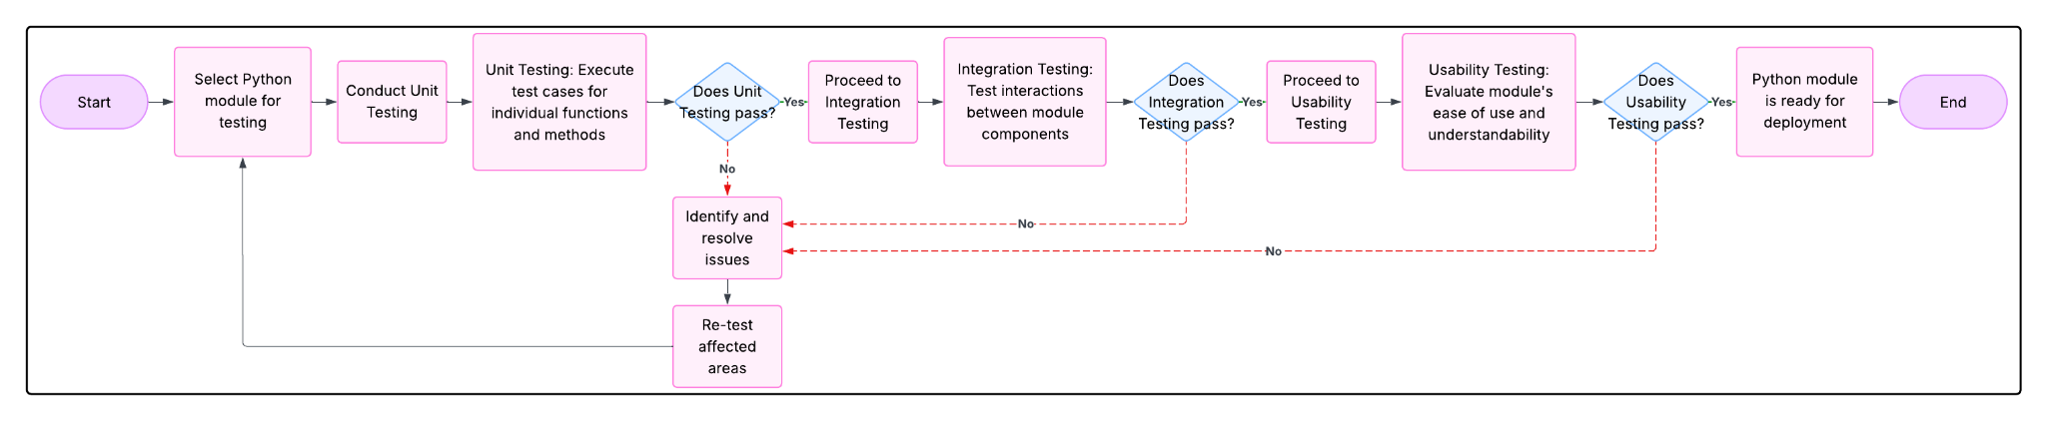
Testing Plan
Notes:
Charles

Slide 31
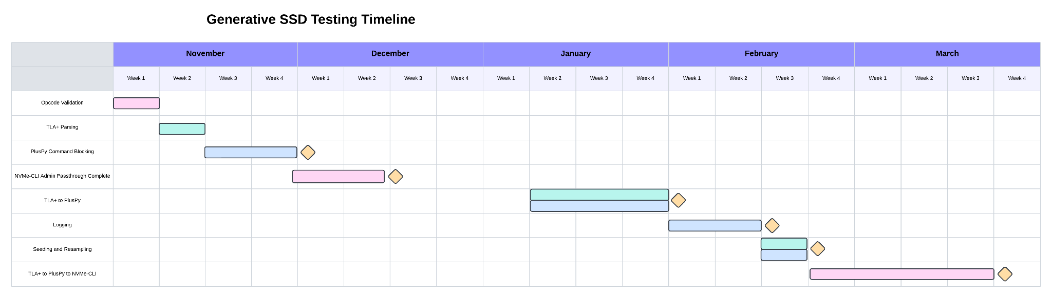
Schedule
Development Schedule - Fall 2024
During the first semester, we identified a few tasks that we needed to complete, and this continued throughout the current semester.
Notes:
Charles - Development Schedule, Fall ‘24

Slide 32
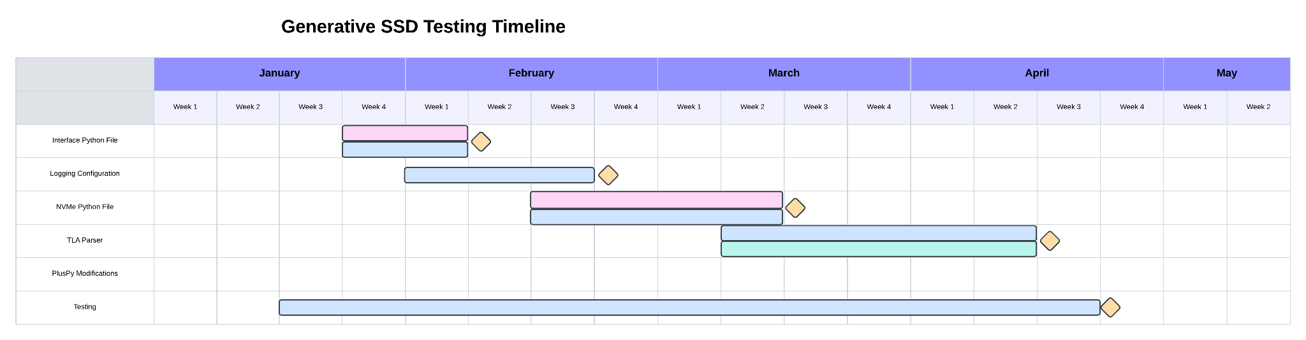
Schedule
Development Schedule - Spring 2025
After the winter break, we re-evaluated the tasks that we needed to complete, and found the tasks to focus on during the semester.
Notes:
Charles - Development Schedule, Spring ‘25

Slide 33
Future Work
Threading with PlusPy
Allows for multiple simulators to communicate
External Communication / Wrappers
Allow for a way to communicate between scripts and the TLA+ model
Improved Simulator Communication
Improve the communication between the PlusPy runner and TLA+ model
Notes:
Charles - Future Work (<1 minute)
Using threads, we can allow for multiple simulators to communicate with each other simultaneously.
This allows for multiple tests to be run concurrently
Our modified library does allow for a way to communicate with other scripts and the TLA+ model, however it is currently not used.
This is an improvement that could be later completed.
Improving the simulator communication
There is more work to be done with getting the PlusPy library and the TLA+ model completely communicative

Slide 34
Conclusion
SSDs are getting faster
This leads to a need for better testing.
Our solution explores every path for testing of an SSD’s functionality.
This should help find weird niche bugs.
Our solution uses TLA+, Python, and NVMe-CLI
We connected up each part, and log it’s output.
Notes:
Charles - Conclusion (~1 minute)

Slide 35

Thank You!
Notes:
Charles?
thank sponsors and mentors
invite to poster

